Slide 1

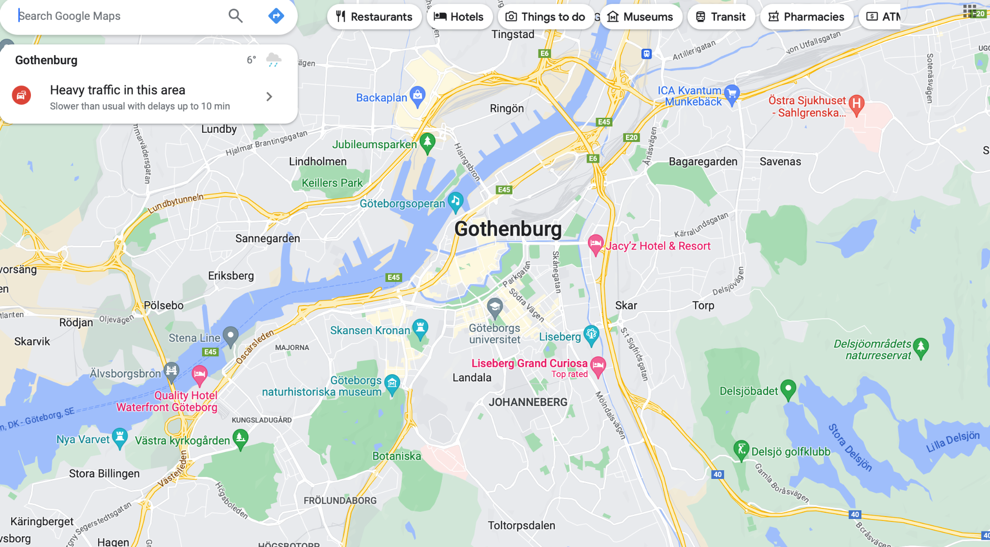
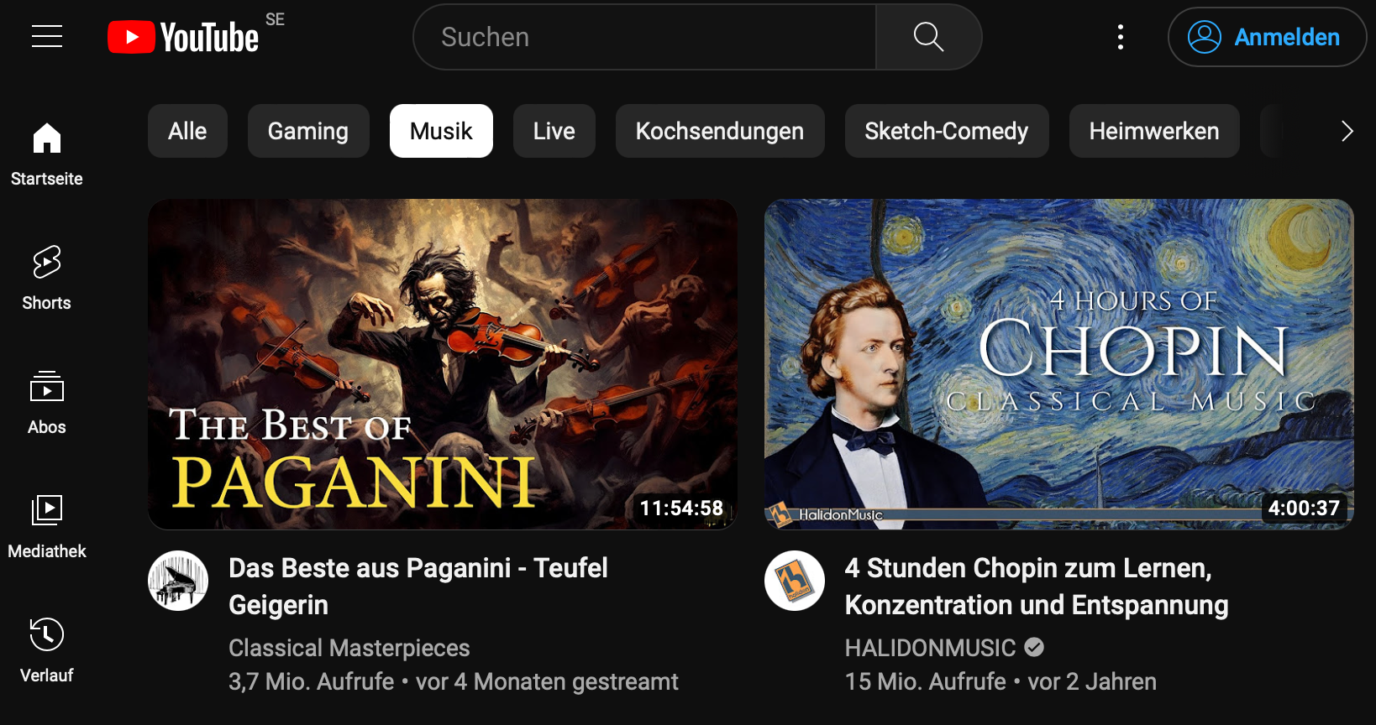
Car Assistent
Project by Jiayun and Katharina

Slide 2
Outline
Introduction
Flow chart
AC
Music
Navigation
Heater
Demo
Difficulties
Future work

Slide 3

WHY
STORY

Slide 4
WHY
STORY
Safety:
the driver can concentrate on driving
Intelligence and Convenience:
Navigation voice assistance and music playback
Customizability and Learning Ability:
the system can learn the driver’s habits
Market Demand

Slide 5
Developed a strong proficiency in...
TS
& JS
HTML
CSS
Figma

Slide 6
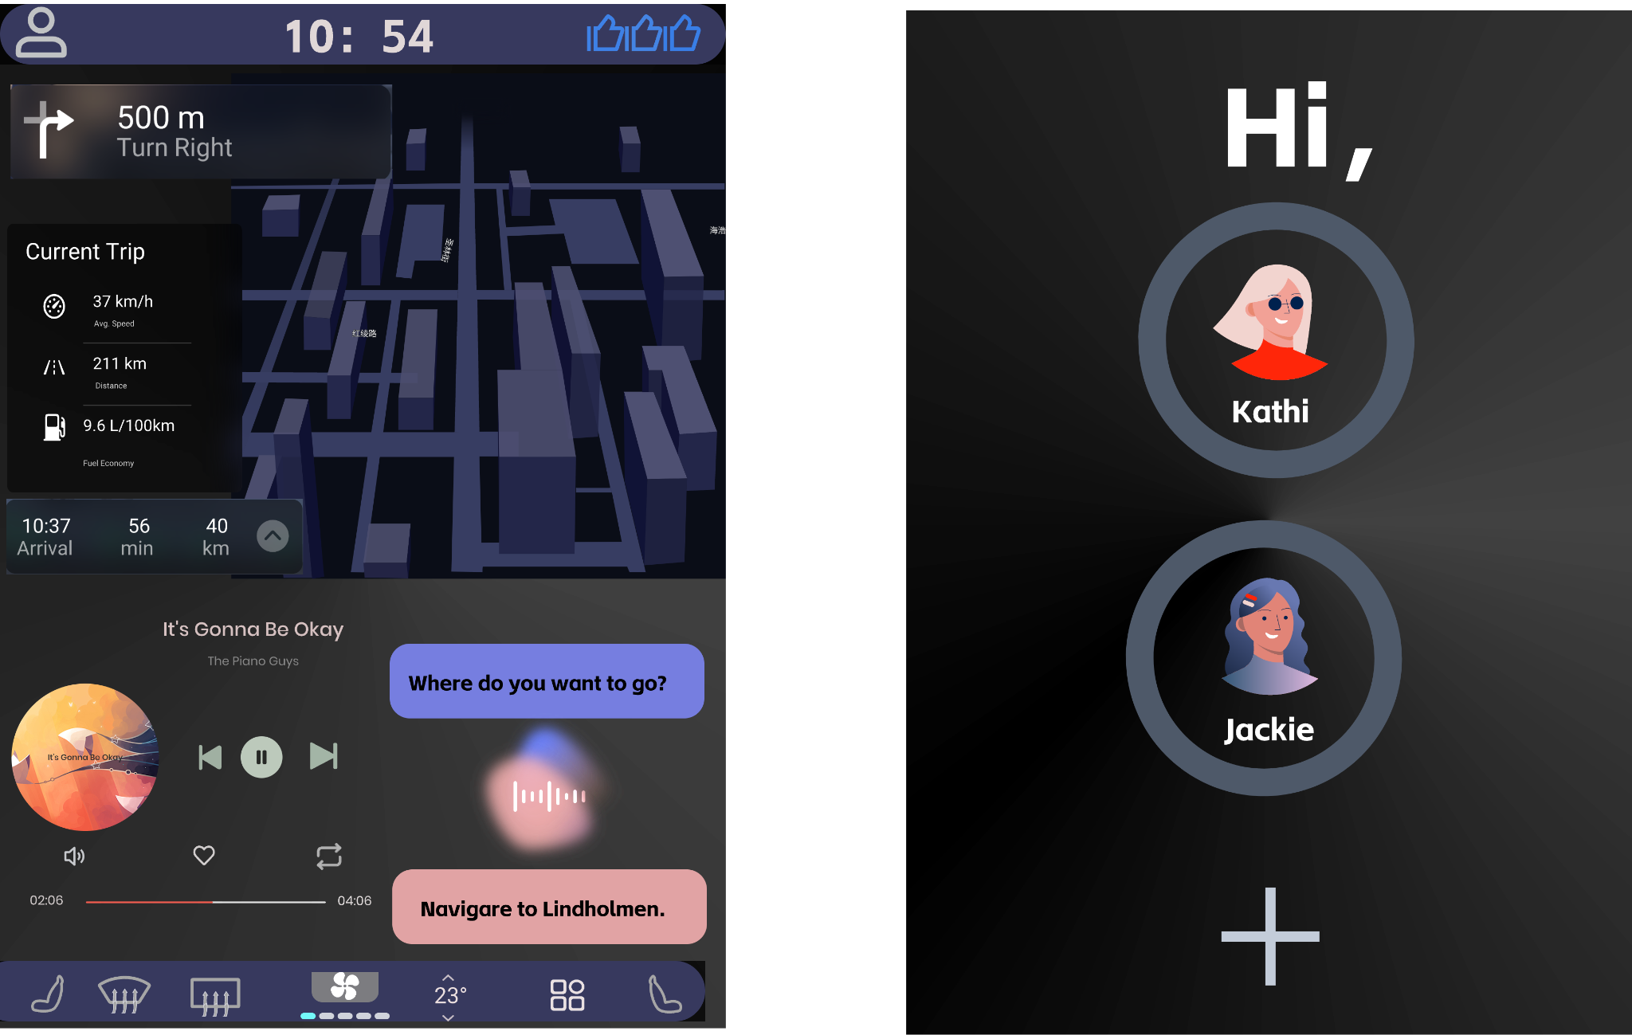


Slide 7
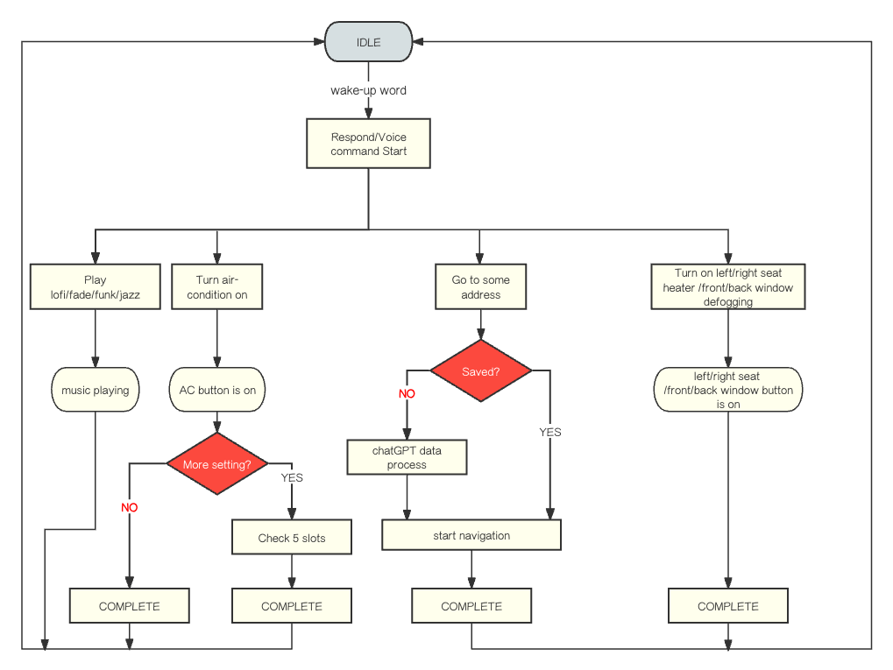
XState Flowchart

Slide 8
Demo

Slide 9
The wake word can only be used once.
The speech-to-text conversion fails.
The current location cannot be displayed.
The speech-to-text conversion is sometimes not very sensitive.
Difficulties we faced

Slide 10
Stopping the music function with voice
Implementing a louder/ quieter function for music
Implementing a function for turning air conditioner off
Implementing degrees for the air conditioner
Difficulties we faced

Slide 11
Future work?
Working on existing functions and completing them
Implementing new functions for the car like googling
Building a helper systems for beginner drivers (new project)

Slide 12
Date | Jiayun | Date | Katharina
02.10 | designed a prototype using Figma. | 08.09 | Working on air conditioner
10.10 | implemented basic map navigation features: route calculation and current location positioning. | 14.09 | Working on air conditioner
12.10 | completed the start voice button and wake word function. | 15.09 | Finished air conditioner
18.10 | integrated voice functionality into map navigation. | 26.09 | Started music
21.10 | completed the transition of prompt icons. implemented speech-to-text conversion. | 28.09- 20.10 | Working on music and modified air conditioner
23.10 | enabled button illumination through both click and voice control | 23.10 | Fixed last issues
25.10 | conducted overall debugging of the system. | 25.10 | Added all to one file

